Slide 1

Online Book Shop

Slide 2
Introduction
Online book shop is an online web application where the customer can purchase books online. Through a web browser the customers can search for a book by its title, later can add to the shopping cart and finally purchase the books.
The main aim of this project is to create a website where a customer can visit and buy books online and have it delivered to his or her doorsteps.
User can view online book detail from anywhere through internet and purchase it with payment from PayPal and credit card.

Slide 3
Problem Statement
ONLINE BOOK SHOP

Slide 4
Objectives
Customer convenience
Unlimited capacity
Enhanced customer experience
Accessibility
Exposure

Slide 5
Choice of the topic with reasoning

Slide 6
Literature Overview
The DataSet contains the copy of the data we requested through the SQL statement. We can use Dataset in combination with OleDbDataAdapterclass . The OleDbDataAdapter object allows us to populate Data Tables in a DataSet. We can use Fill method in the OleDbDataAdapter for populating data in a Dataset.
OleDbCommand Object :
Represents a set of data commands and a database connection that are used to fill the DataSet and update the data source.
OleDbDataRow :
A DataRow contains an individual row of data. It narrows the data abstraction to the level of the row. The DataRow type provides ways to add, remove, or read cells from the enclosing data structure.

Slide 7
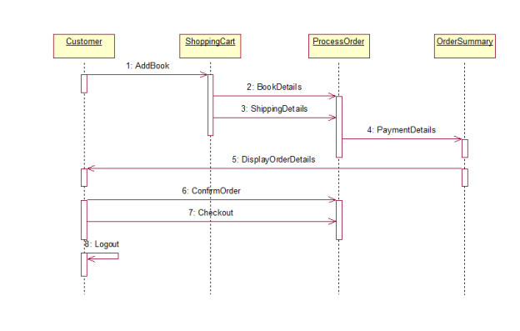
System architecture

Slide 8
Modules
User Registration
Book Details Entry
Search Book
View Book
Add to Cart
Payment

Slide 9
Methodologies
Agile methodology :
Is an iterative project management strategy that allows a project to adapt to changing working conditions and develop in a short amount of time. In this method, which is referred to as "sprint," a project term is divided into shorter and repeatable stages. Sprint lengths were decided during the project's early planning stages and will be reflected in the final product.

Slide 10
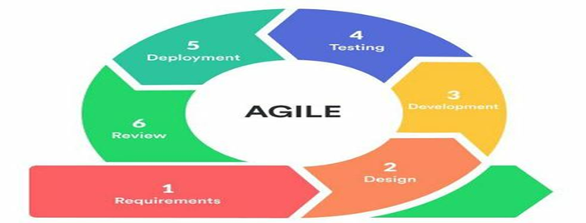

Slide 11
Result and Discussion

Slide 12
Advantages
Customers can get their book delivered instead of actually going and buying the book.
They can make payment online itself.
Managing of inventory in the shop for shopkeeper becomes easier as customers are not visiting and ordering online.
This system saves both time and travelling cost of customers.
User can get to know different kinds of books that they were unaware of by just searching in the system using keywords.

Slide 13
Conclusion
This project is efficient in maintaining users records and can perform operations on it, also reduces the work load on the shop owner of knowing the quantity of books available and which books are available and keeps the records of how many books are purchased and sold.

Slide 14
Reference
https://en.wikipedia.org/wiki/Bookselling
https://www.techopedia.com/definition/23889/web-development
http://php.net/manual/en/intro-whatis.php
https://www.mysql.com/about/
https://en.wikipedia.org/wiki/MySQL
https://www.w3schools.com/php/php_mysql_intro.asp

Slide 15
Thank You

